Slide 1
Lecture 5a
Communication Impairments
Noise, Loss, and Delay

Slide 2
So far…
Signaling
Line codes
Modulation
Analog and Digital
Next
Noise, Attenuation, Delay

Slide 3
Noise
Noise is any undesirable signal that impacts the quality of a desired signal
Example: Static or crackle in analog audio
Example: Snow in analog video transmission
Example: Bit errors in digital transmission

Slide 4
Communications Impairments
Analog signals and systems have various impairments that affect the signal
Important ones that warrant detailed treatment
Noise
Loss
Delay
Others include cross-talk, reflection, dispersion, and distortions

Slide 5
Analog signals and noise
Imagine trying to speak when a vacuum cleaner is running
You have to shout on top of the “noise” that it makes
Increase the “power” in your voice and thus the signal-to-noise ratio
The noise “adds” to your speaking
In telecommunication networks noise comes from
Electromagnetic interference (EMI)
System processing

Slide 6
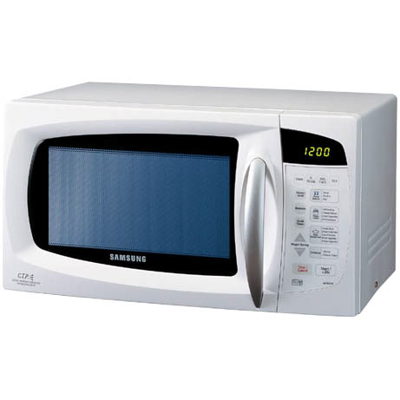
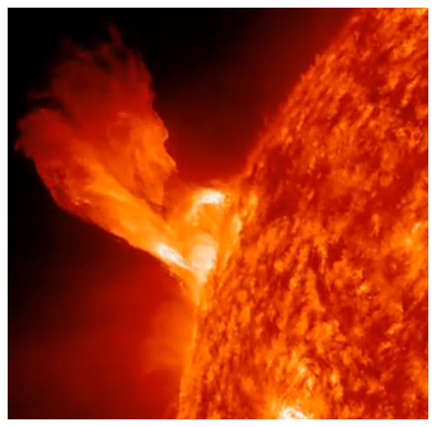
Noise and Distance
Signals get weaker over distance
But noise keeps getting added up
Eventually the noise becomes too loud to receive the signal
Try tuning in to your favorite radio station about 50 miles from your city
Notes:
^{Lightning discharges}
Interfering transmissions from other communications equipment
^{Solar flares}
^{Emissions from space}
^{Lawnmowers and hairdryers}
^{Microwave ovens}

Slide 7
Additive White Gaussian Noise (AWGN)
White Noise
Background or thermal noise
Due to random fluctuations of electrons - function of absolute temperature
Adds to the signal
Most noise adds to the signal, but some multiply with the signal
Ideal case
There will always be AWGN, but hopefully that is all there is
Notes:
As I mentioned earlier, Shannon-Hartley is the reason for the additional capacity of STP vs. UTP. Essentially, the shielding reduces noise on the signal, which increases the SNR, which, in turn, increases capacity.

Slide 8
Questions
What is signal quality?
How does noise impact signal quality?

Slide 9
Impact of noise on digital signals
The received signal can get seriously affected by noise
The receiver has to be able to interpret the result correctly for reliable data transmission

Slide 10
Signal-to-Noise Ratio
Measure of “quality” of the received signal
Ratio of the signal power to noise power at a receiver SNR = S/N where S and N in watts (W) or milliwatts (mW)
SNR_{dB} = 10 log₁₀ (S/N) in decibels (dB)
What is dB?
High SNR
Low SNR

Slide 11
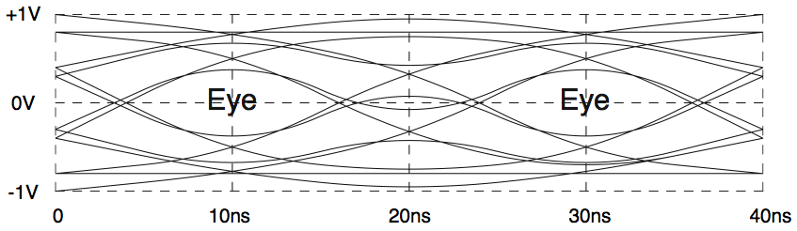
Eye Diagram
Oscilloscope trace of 14 4-bit binary signals
Middle two bits overlapped on a single display
Demonstrates issues with digital signals
Note “eye”
Cursive Vs print

Slide 12
Observations
Attenuation through channels close the “eye”
Detecting bits involves sampling
Sampling => need to find the sweet spot
Dispersion and inter-symbol interference (ISI)
All impact bit error rates
What fraction of detected bits are in error?

Slide 13
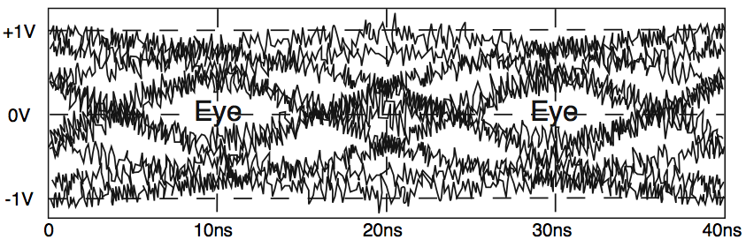
Noise and Eye Diagram
The eye is closed more!
Attenuation lowers the upper eyelid and raises the lower eyelid
Noise blurs the distinction between the two
Signal-to-noise ratio!

Slide 14
Review of Logarithms
General Properties
log (a×b) = log (a) + log (b)
log (a/b) = log(a) – log(b)
log_{n}(n) = 1
n^{logn(x)} = x
log_{n}(x)=log₁₀(x)/log₁₀(n)
Review: http://www.khanacademy.org/math/algebra/logarithms-tutorial

Slide 15
Measuring Power: Decibels
Relative power ratios (signal strength ratios) are expressed in decibels (dB) for ease of calculation
10 log₁₀(ratio)
Ratio has no units
Example: A cell phone receives a signal with average power of 4 W and noise power of 0.5 W what is the SNR in dB?
SNR_{dB} = 10 log₁₀ (S/N) = 10 log₁₀ (4/0.5) = 9.03 dB

Slide 16
dB Scale (2)
It is a logarithmic scale – “decibel”
Used extensively in Telecom – simplifies math
Multiplication becomes addition, exponentiation becomes multiplication
It is a “relative measure” – dimensionless arguments to the log
Always need a baseline - for a general baseline, the unit is dB
It measures energy or power, not voltage or current
The power at point A P_{A} is greater than the power at point B P_{B} by X dB, if 10 log₁₀(P_{A}/P_{B}) = X
The reason for multiplying it by 10 is that this is “deci” bels, not bels

Slide 17
dB Calculations (1)

Slide 18
dB Calculations (2)

Slide 19
Absolute values in dB
If we have a transmitter sending a signal with transmit power x W, how can we represent this in dB?
Use some known quantities as a reference
Typically, we use 1 mW or 1 W as the reference
If the reference is 1 mW, the actual value is expressed in dBm
If the reference is 1 W, the actual value is expressed in dBW
Example:
If the transmit power is 100 mW, in dBm, it is
10 log(100 mW/1mW) = 10 log(100) = 20 dBm
or in dBW, it is
10 log(100 mW/1W) = 10 log(0.1) = −10 dBW

Slide 20
Loss
Two problems of “Tele”communications
Deliver signal to many destinations
Destinations are far away ⇒ Loss of signal power between transmitter and receiver
Two types of losses
Dissipation – energy gets scattered in many directions and loses intensity
Attenuation – energy is absorbed (maybe converted to heat) and thus losses intensity

Slide 21
Dissipation
Consider a light bulb that emits light at intensity P_{t} = 125.6 W
At a distance r from the bulb, the intensity is distributed over a sphere of radius r and area 4πr²
The density of intensity is P_{t}/4πr² = 10/r² W/m²
Let us suppose that the “receiver” is a sheet of paper of area 1 m²
What is the total intensity P_{r} received by the paper at different distances?
At r = 5m, P_{r} =10/25 = 0.4 W
At r = 10m, P_{r} =10/100 = 0.1 W
As the distance doubles, the received intensity falls by ¼
We say the signal power has dissipated as P_{r} = k P_{t}/r² where k is a constant

Slide 22
Attenuation
A foggy room with a light bulb (or a laser)
Light intensity drops even if it did not spread
Absorption of energy by fog causes “attenuation”
Telecommunications example
We want to make the time-varying voltage at point A known at point B
Suppose we connected the two points by a wire
The energy in the signal at A will be larger than the energy of the signal at B
Why?
Not because the energy is spread in space
The energy is lost as heat or absorbed along the wire
It is like “friction” – the lost heat cannot be usefully employed

Slide 23
dB Example (1)
Let the signal power at the input of an optical link be P₁ = 0.1 W
Let the signal power at the output of the optical link be P₂ = 0.05 W
We will say that “P₂ is 3 dB smaller than P₁” because
10 log₁₀ P₂/P₁ = 10 log₁₀(1/2) ≈ −3dB
So if the power in a signal gets reduced by half every km, we will say
The attenuation loss is 3 dB per km

Slide 24
Copper Wire Example
3

Slide 25
Optical Fiber Example

Slide 26
Radio Link Example

Slide 27
Link Power Budget
Balance sheet of gains and losses in a system
Allows you to determine
Coverage of your communication link
How far can the signals go?
Transmit power
Receiver capability
Different components for different systems
Optical Vs Copper Vs Wireless

Slide 28
Basic Concept of Link Budget

Slide 29
Link Budget—Transmit Power
The distance between transmitter and receiver is 6 km, the loss factor is 3 dB per km. At the receiver side, the noise level is 3 dBm. The received signal power needs to be twice as large as noise in order for receiver to differentiate the signal from noise. What is the minimum transmission power level?

Slide 30
Link Budget –Maximum transmission Distance
The transmission power is 20 dBm, it losses 3 dB per Km. The noise level increase 1 dB per Km. Receivers require the SNR to be 3 dB. What is the maximum transmission distance on this line?

Slide 31
Delay
Not significant in single link one-way broadcast
Has cognitive impact in interactive communications
Causes
Transmission, queueing, propagation, processing
Finite velocity of signals in media
Capacitive and inductive effects slow down signals
Depending on cable, the speed is 5% to 75% of the speed of light
What is the delay between LA and Boston (4800 km) if the speed of transmission on a copper link is 0.2c?

Slide 32

Sources of Delay
transmission
A
propagation
B
nodal
processing
queueing
d_{nodal} = d_{proc} + d_{queue} + d_{trans} + d_{prop}
Notes:
32

Slide 33
Processing Delay
The time required to examine the packet’s header and determine where to direct the packet.
Other factors: time needed to check for bit-level errors
Processing delays in high-speed routers are typically on the order of microseconds or less.

Slide 34
Queueing Delay
Packets queue in router buffers
Packets arrival rate to link (temporarily) exceeds output link capacity
Packet queue, wait for turn
Arriving packets dropped (loss) of no free buffers
Factors that impact queueing delay
Arrival:
packet length (L) in bits
average packet arrival rate (a)in packets per second
Departure rate (R): link bandwidth in bps
La/R determines the queue length

Slide 35
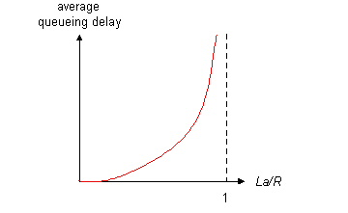

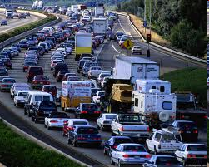
Queueing Delay (cont’d)
La/R determines the queue length
~0: average queueing delay is small
->1: average queueing delay is large
>1: more arrival than can be serviced, average delay increase to infinity
La/R ~ 0
La/R -> 1

Slide 36
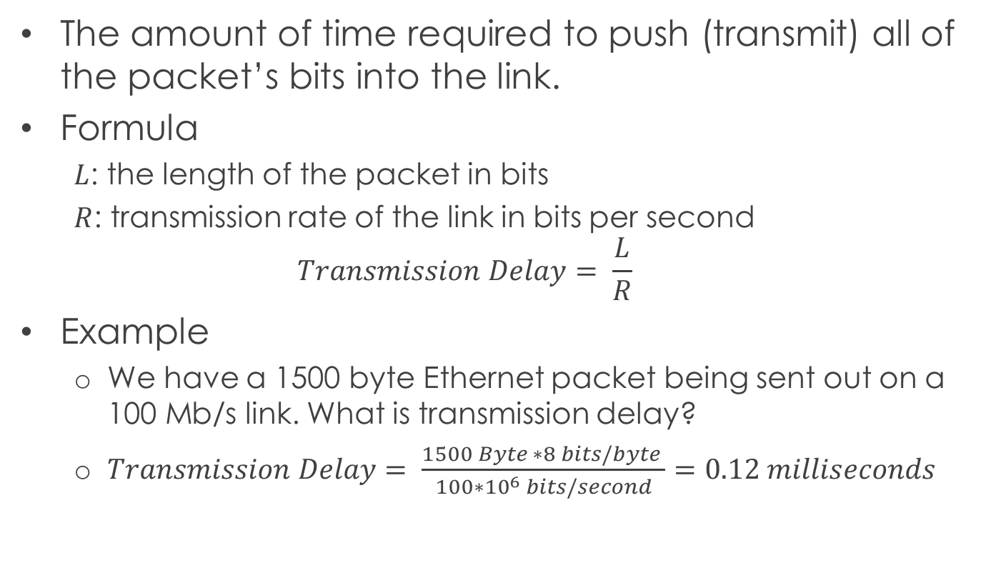
Transmission Delay
The amount of time required to push (transmit) all of the packet’s bits into the link.
Formula
$L$: the length of the packet in bits
$R$: transmission rate of the link in bits per second
$$Transmission Delay= \frac{L}{R}$$
Example
We have a 1500 byte Ethernet packet being sent out on a 100 Mb/s link. What is transmission delay?
$Transmission Delay= \frac{1500 Byte ∗8 bits/byte }{100∗{10}^{6} bits/second}=0.12 milliseconds$

Slide 37
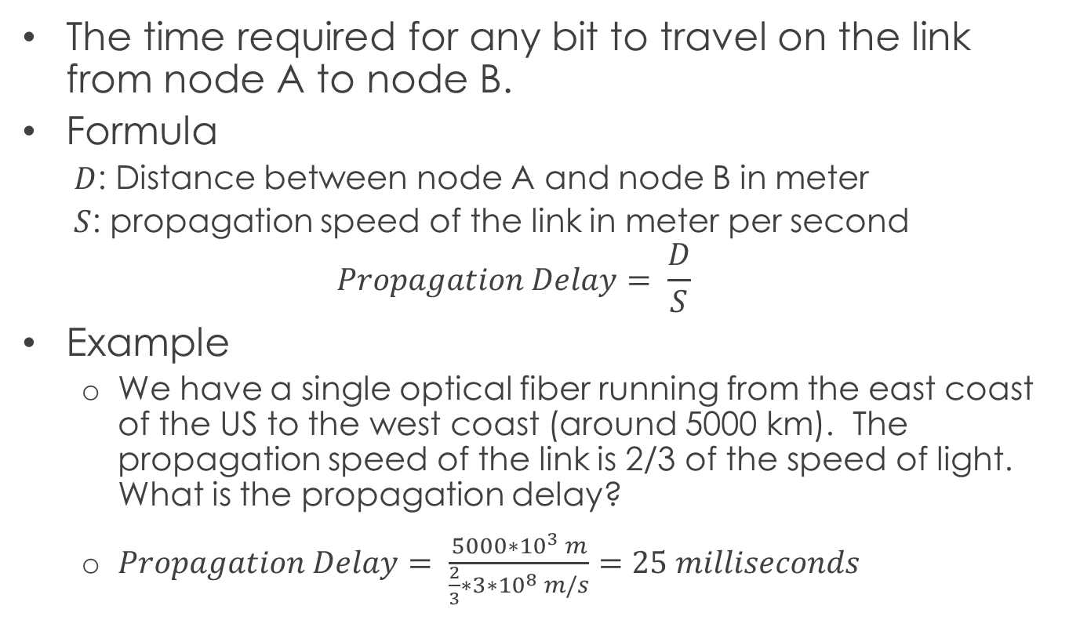
Propagation Delay
The time required for any bit to travel on the link from node A to node B.
Formula
$D$: Distance between node A and node B in meter
$S$: propagation speed of the link in meter per second
$$Propagation Delay= \frac{D}{S}$$
Example
We have a single optical fiber running from the east coast of the US to the west coast (around 5000 km). The propagation speed of the link is 2/3 of the speed of light. What is the propagation delay?
$Propagation Delay= \frac{5000∗{10}^{3} m}{\frac{2}{3}∗3∗{10}^{8} m/s}=25 milliseconds$

Slide 38
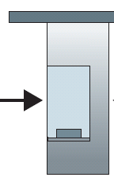
Caravan Analogy
Cars “propagate” at 100 Km/hr
Toll booth takes 12 sec to service a car (bit transmission time)
Analogy: car ~ bit; caravan ~ packet
Question: How long until caravan is lined up before 2nd toll booth?
100 km
100 km
ten-car
caravan
toll
booth
toll
booth

Slide 39
Caravan Analogy (cont’d)
Time to “push” entire caravan through tool booth onto highway = 12 sec/car * 10 cars = 120 sec
Time for a car to “propagate” from the 1st toll booth to the 2nd toll booth = 100 Km/(100Km/hr)=1hr
Answer = 120 sec + 1 hr = 62 minutes
100 km
100 km
ten-car
caravan
toll
booth
toll
booth

Slide 40
Caravan Analogy (cont’d)
Suppose
cars now “propagate” at 1000 Km/hr
Toll booth now takes one minute to service a car
Question: Will cars arrive to 2nd booth before all cars serviced at first booth?
Answer: Yes! Why?
Animation
100 km
100 km
ten-car
caravan
toll
booth
toll
booth

Slide 41
Real World Problem 1
There are two competing links between locations A and B separated by 1 km. The first uses fiber of length 10km over which the light signal propagates at 2/3 the speed of light. The transmission rate on the fiber link is 10Gbps. The second uses a UTP cable of length 1.5 km over which the electrical signal propagates at 0.7 times the speed of light. The transmission rate is 100 Mbps. If you wish transfer a 100 MByte file between A and B, which option would provide you the shortest overall delay? Assume the overall delay includes only the transmission delay and the propagation delay.

Slide 42

Solution to Problem 1
Fiber
Fiber
$D_{t}=\frac{100∗{10}^{6} bytes ∗8 bits/byte}{10∗{10}^{9} bps}$
$D_{p}=\frac{10∗{10}^{3}m}{\frac{2}{3}∗3∗{10}^{8}m/s}$
$Total Delay= D_{t}+D_{p}$
UTP
$D_{t}=\frac{100∗{10}^{6} bytes ∗8 bits/byte}{100∗{10}^{6} bps}$
$D_{p}=\frac{1.5∗{10}^{3}m}{0.7∗3∗{10}^{8}m/s}$
$Total Delay= D_{t}+D_{p}$
Tran: 100 MB, 10 Gbps
Prop: 10 Km, 2/3 speed of light
1 Km
A
B
1.5 Km
UTP
Tran: 100 MB, 100 Mbps
Prop: 1.5 Km, 0.7 speed of light

Slide 43
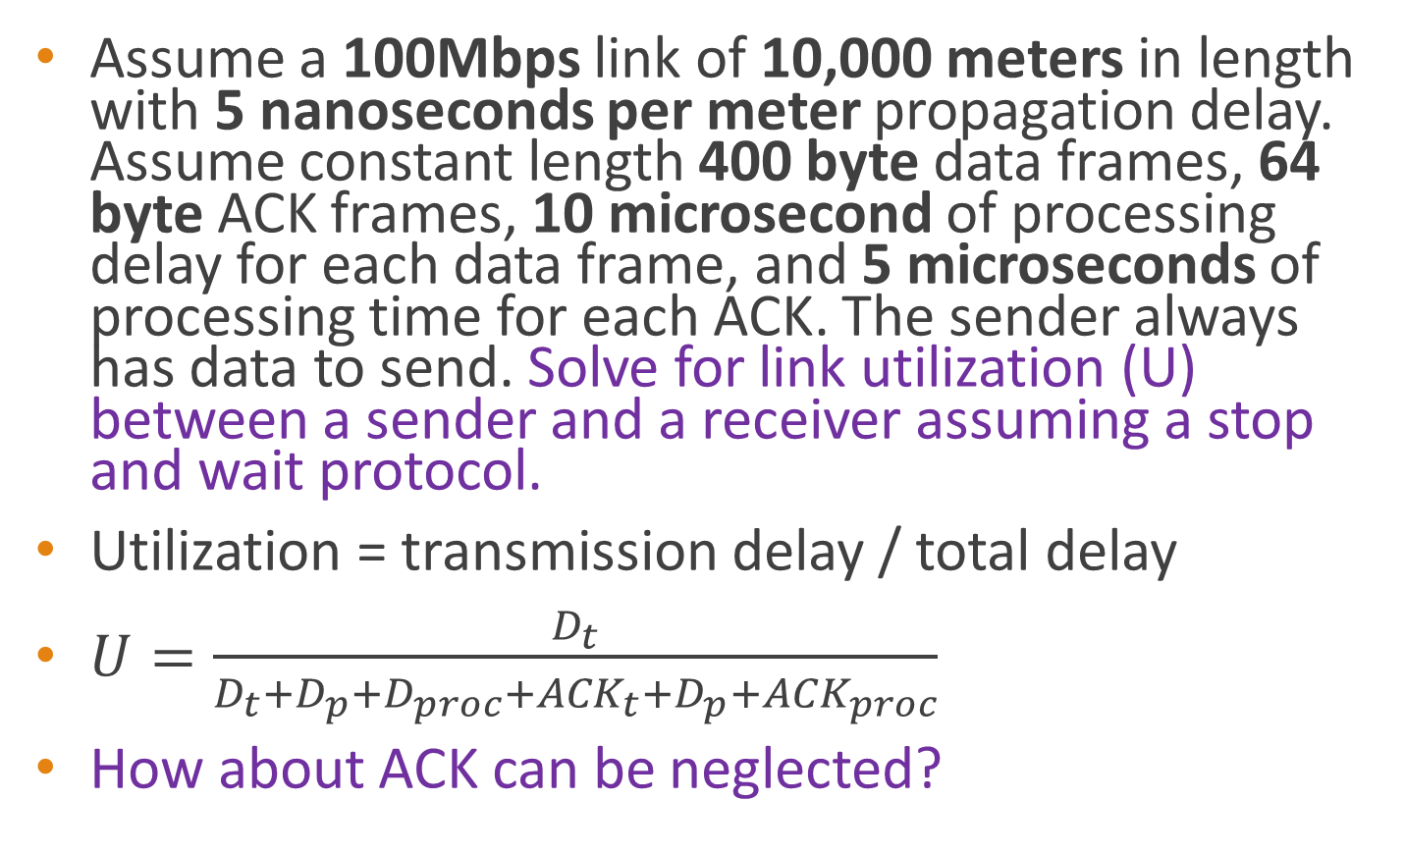
Real World Problem 2
Assume a 100Mbps link of 10,000 meters in length with 5 nanoseconds per meter propagation delay. Assume constant length 400 byte data frames, 64 byte ACK frames, 10 microsecond of processing delay for each data frame, and 5 microseconds of processing time for each ACK. The sender always has data to send. Solve for link utilization (U) between a sender and a receiver assuming a stop and wait protocol.
Utilization = transmission delay / total delay
$U=\frac{D_{t}}{D_{t}+D_{p}+D_{proc}+{ACK}_{t}+D_{p}+{ACK}_{proc}}$
How about ACK can be neglected?

Slide 44
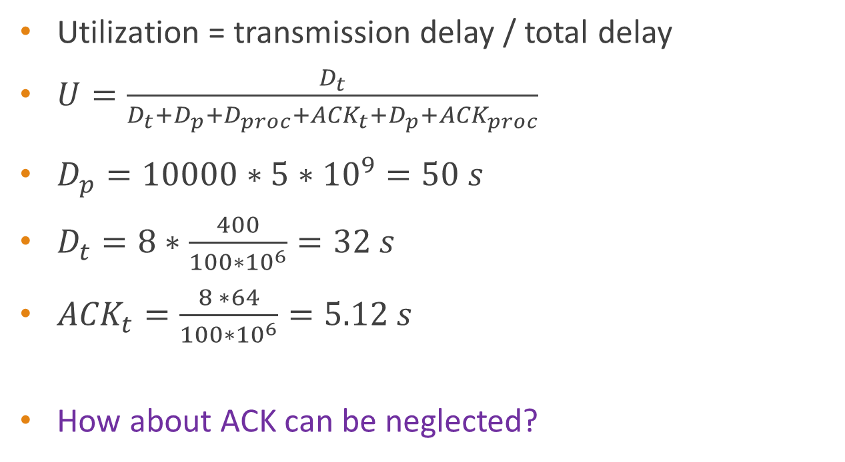
Solution to Problem 2
Utilization = transmission delay / total delay
${U=\frac{D_{t}}{D_{t}+D_{p}+D_{proc}+{ACK}_{t}+D_{p}+{ACK}_{proc}}}_{}$
$D_{p}=10000∗5∗{10}^{9}=50 s$
$D_{t}=8∗\frac{400}{100∗{10}^{6}}=32 s$
${ACK}_{t}=\frac{8 ∗64}{100∗{10}^{6}}=5.12 s$
How about ACK can be neglected?

Slide 45

Real World Problem 3
Frames are generated at node A and sent to node C through node B. Determine the minimum transmission rate required between node B and C so that the buffers at node B are not flooded, based on the following:
The data rate between A and B is 100 kbps
The propagation delay is 5 milliseconds/Km for both lines
There are full-duplex, error-free lines between the nodes
All data frames are 1000 bits long; ACK frames are separate frames of negligible length
Between A and B, a sliding-window protocol is used, with a window size of 3
Between B and C, stop and wait is used.

Slide 46
Solution to Problem 3 (1)
In order not to flood the buffers of B, the average number of frames entering and leaving B must be the same over a long interval.
Link A-B:
Propagation delay = 4000 *5 µsec = 20 msec
Transmission delay = 1000/(100*1000)=10 msec
Link B-C:
Propagation delay = 1000 *5 µsec = 5 msec
Transmission time per frame (x) = 1000/R
R = data rate between link B and C

Slide 47
Solution to Problem 3 (2)
A can transmit three frames to B and then must wait for the ACK of the first frame before transmitting additional frames. The first frame takes 10 msec to transmit; the last bit of the first frame arrives at B 20 msec after it was transmitted and therefore 30 msec after the frame transmission began. It will take an additional 20 msec for B’s ACK to return to A. Thurs, A can transmit three frames in 50 msec.
B can transmit one frame to C at a time. It takes 5+x msec for the frame to e received at C and an additional 5 msec for C’s ACK to return to B. Thus, B can transmit one frame every 10+x msec, or three frames every 30+3x msec.
Therefore, 30+30x=50, R=?

Slide 48
“Real” Internet Delays
what do “real” Internet delay & loss look like?
traceroute program: provides delay measurement from source to router along end-end Internet path towards destination. For all i:
sends three packets that will reach router i on path towards destination
router i will return packets to sender
sender times interval between transmission and reply.
3 probes
3 probes
3 probes
3 probes

Slide 49
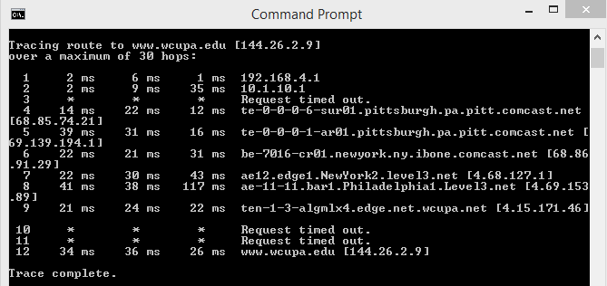
“Real” Internet Delays
1 is the internet gateway on the network this traceroute was done from
2 is the ISP the origin computer is connected to
4-6-8. Pittsburgh-New York – Philadelphial
9 reach the edge router to wcupa

